Slide 1
Metabolomics repositories, standards and challenges
Claire O’Donovan
Head of Metabolomics
www.ebi.ac.uk/about/people/Claire-odonovan

Slide 2
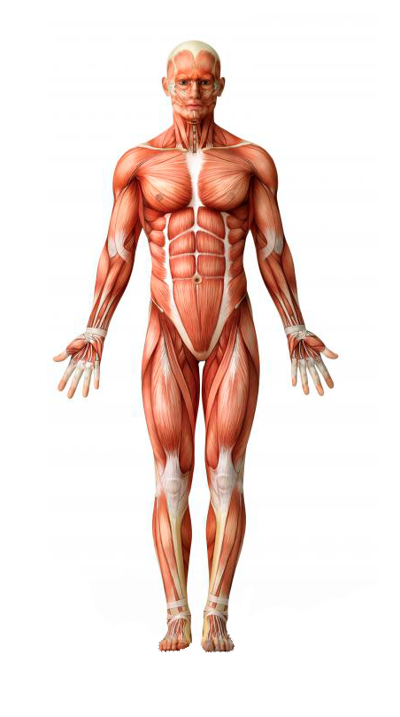


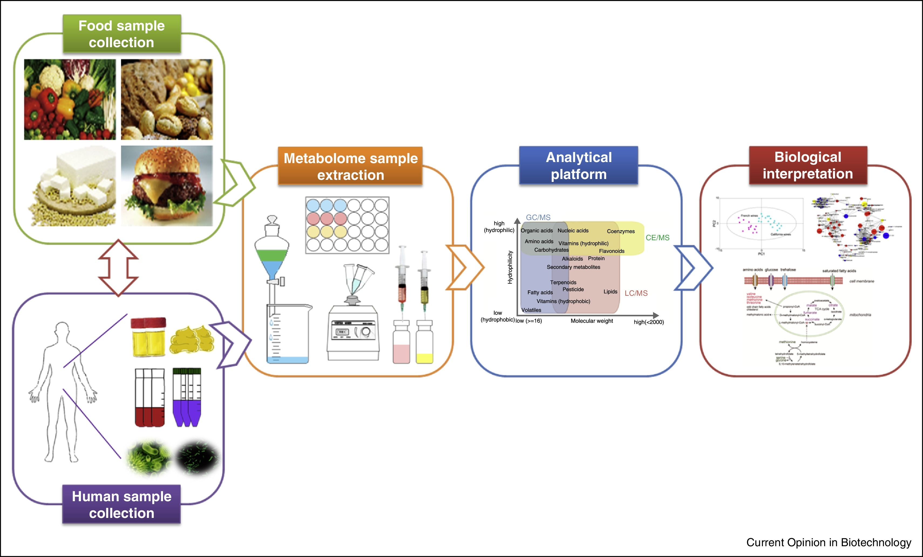
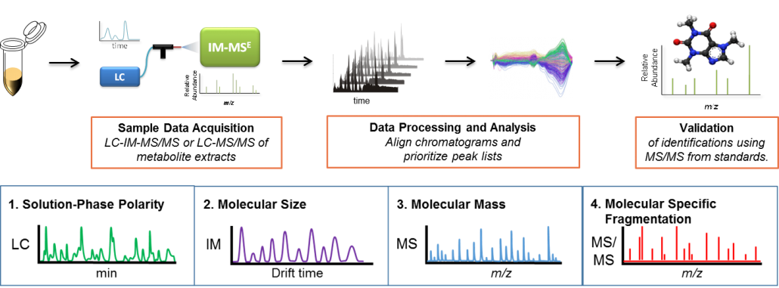
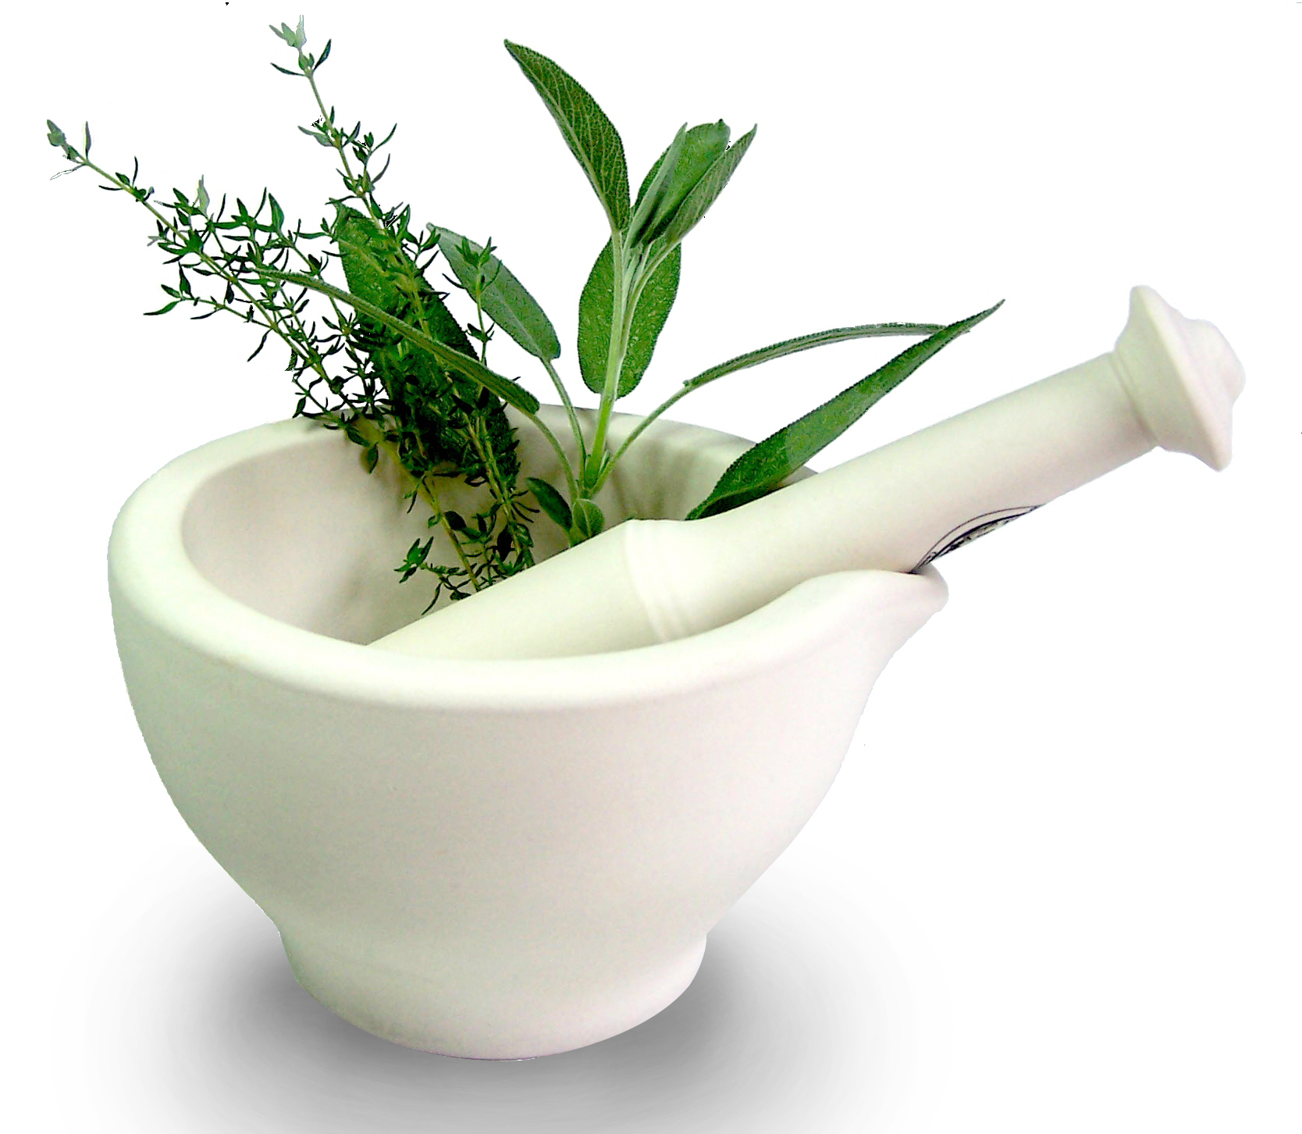
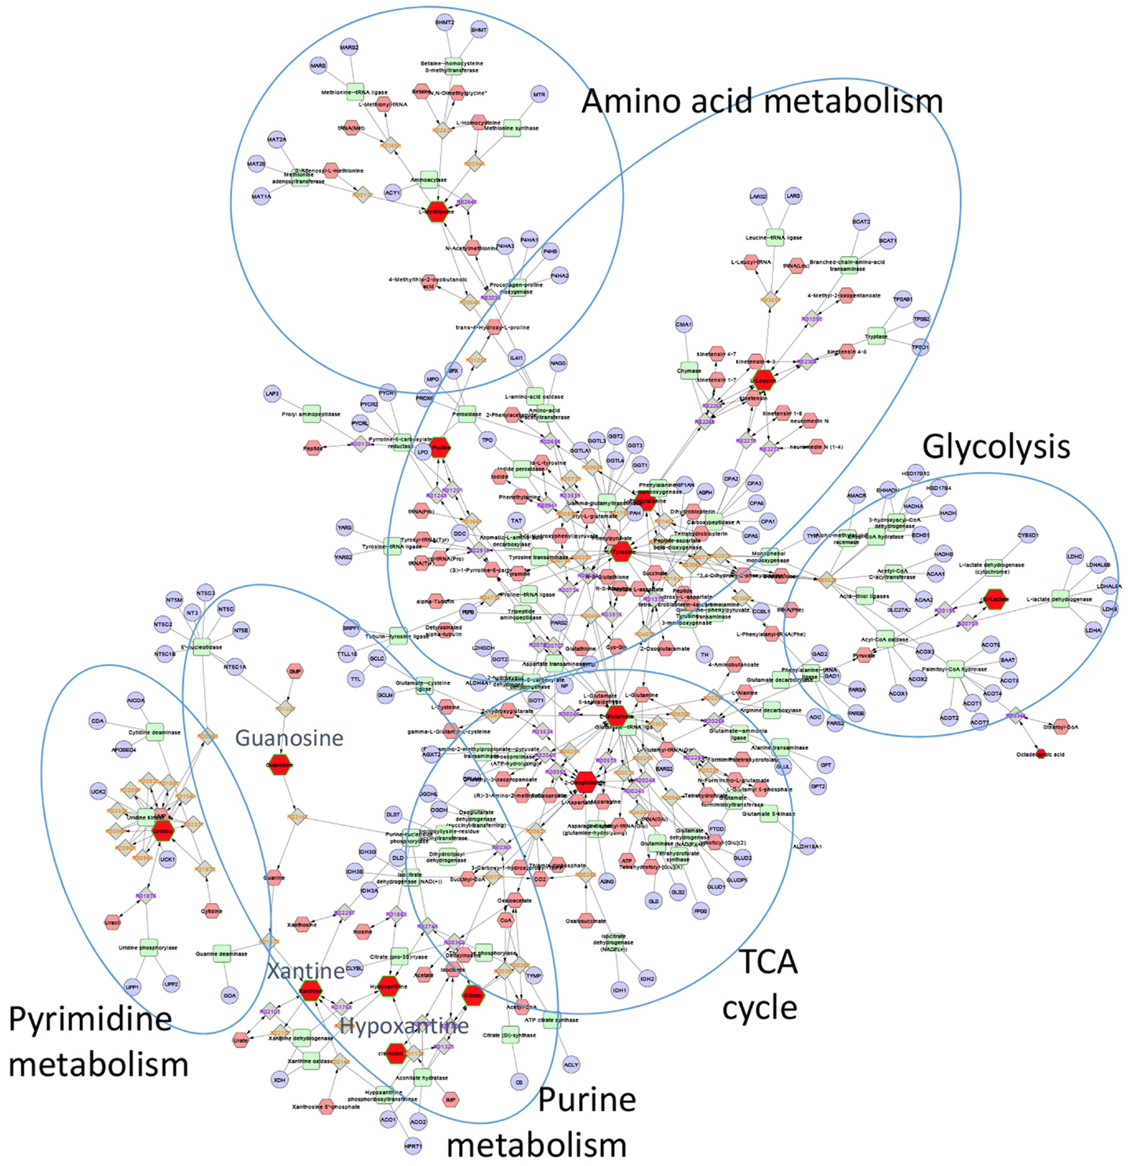
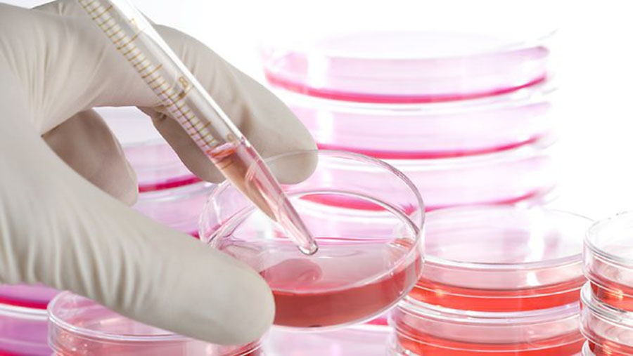
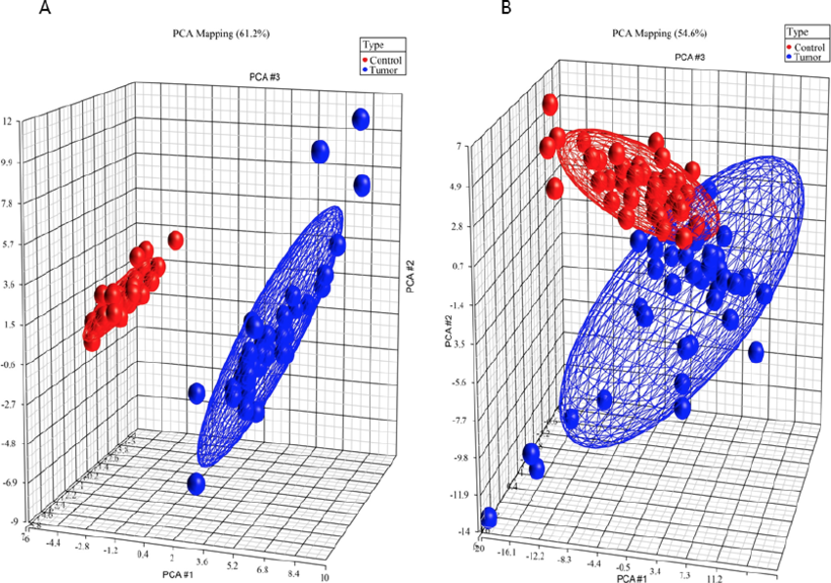
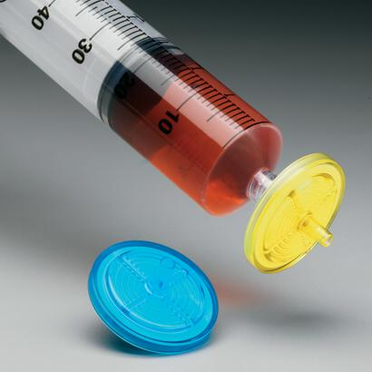
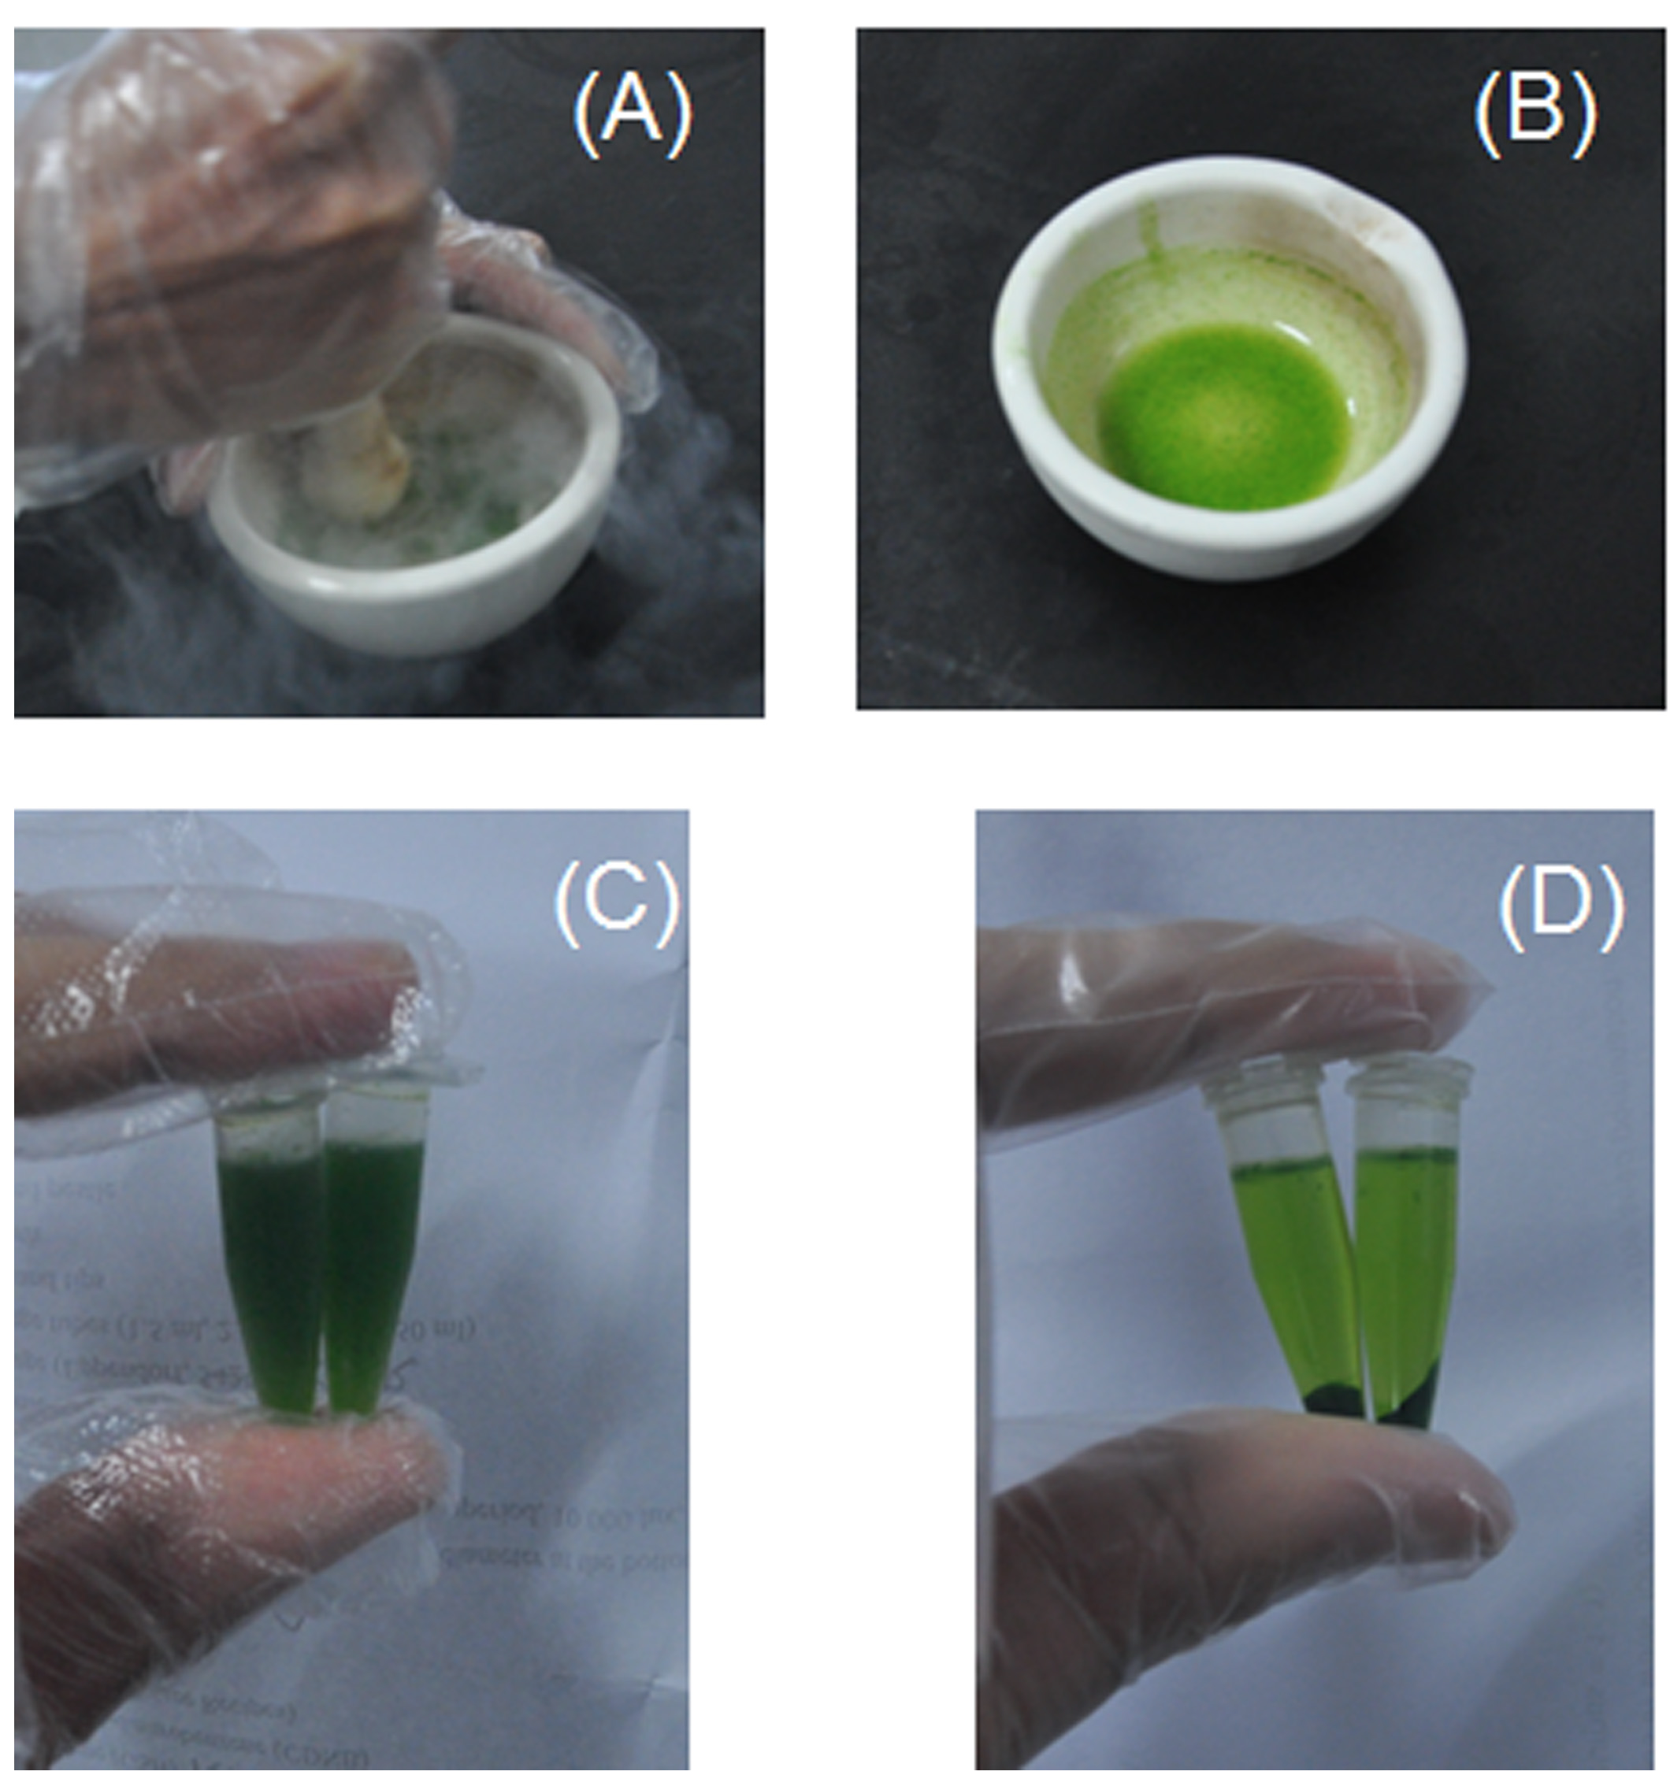
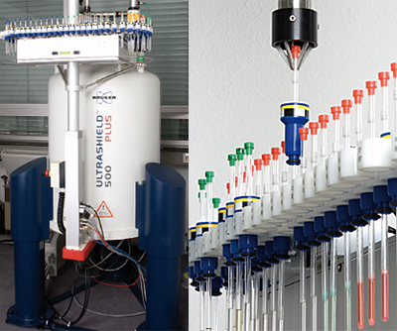
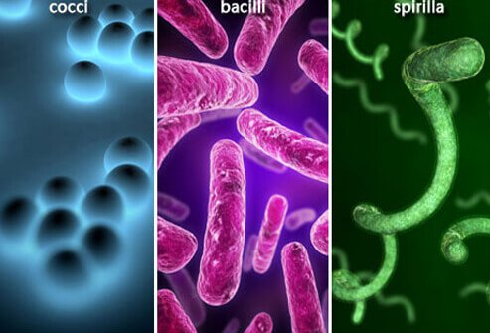
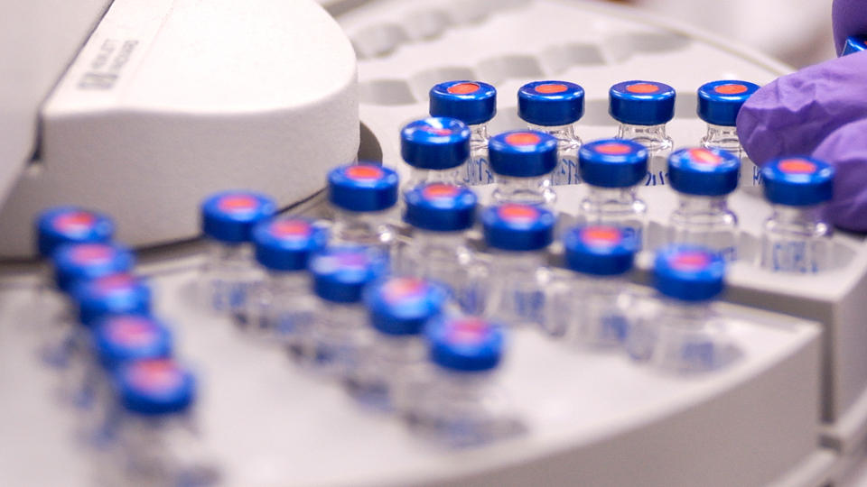

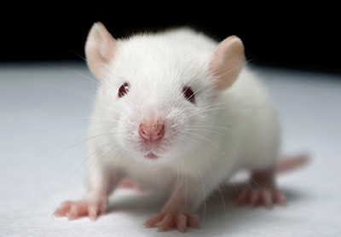
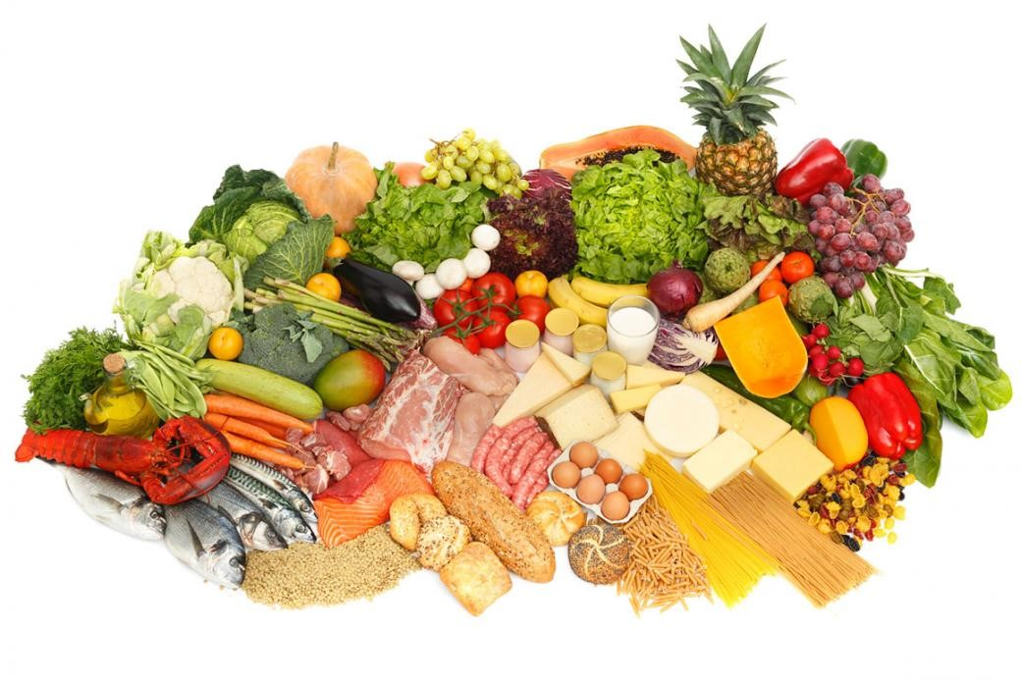
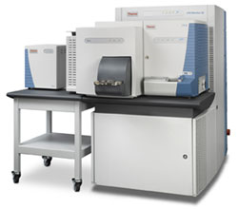
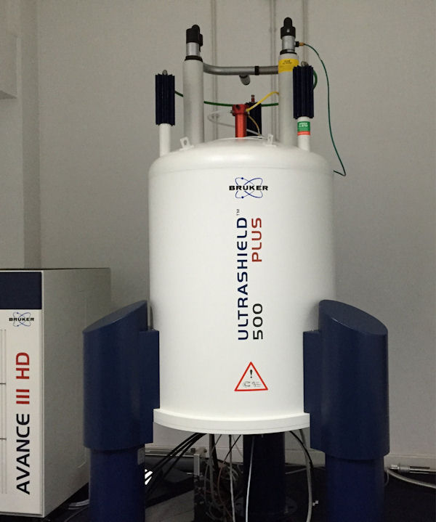
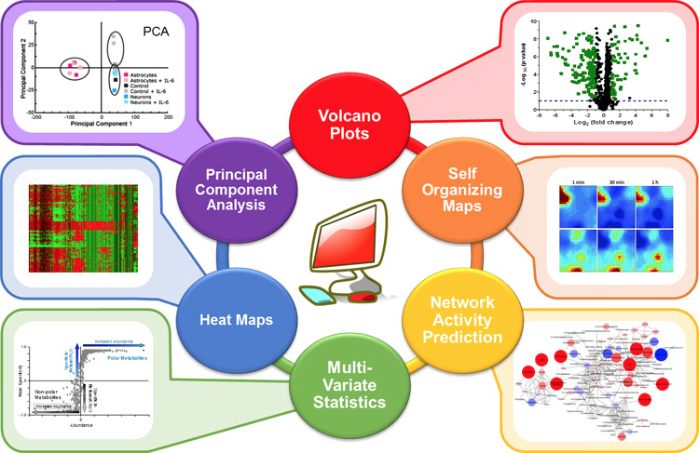

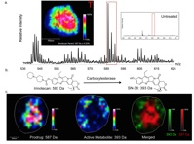


Metabolomics: study design
Sample Collection
Sample Preparation
Analytical Analysis
Data Interpretation
Typical workflow

Slide 3

Building blocks
Federated Data Sharing, Databases and Repositories
Minimum information reporting guidelines + Raw data and Open Access Data Standards
Infrastructure to store, access analyse the information

Slide 4
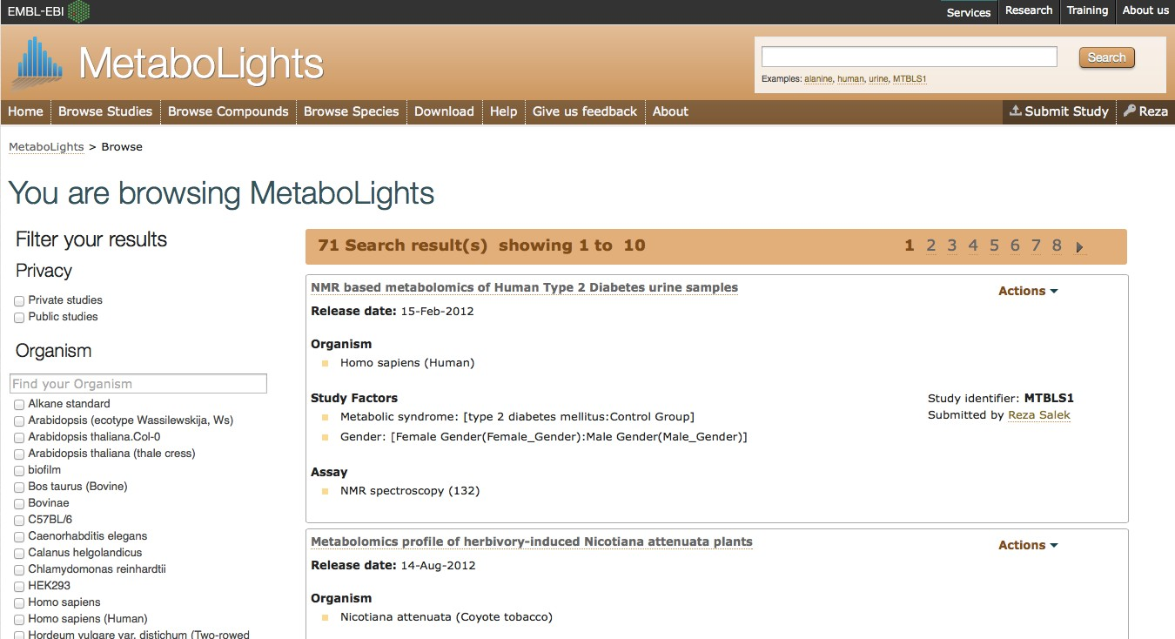
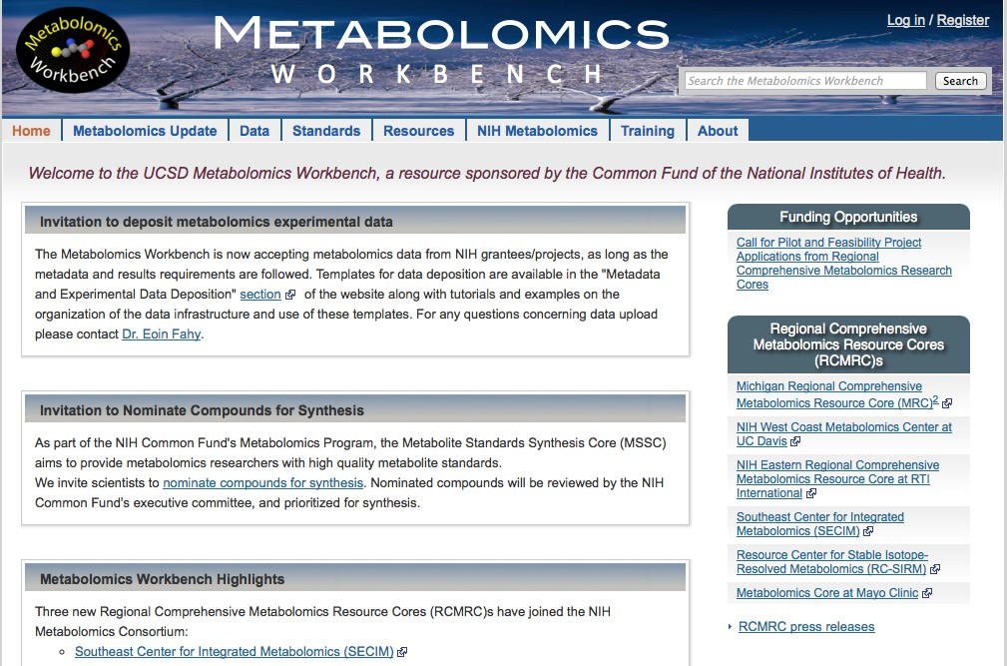
Data sharing repositories
http://www.metabolomicsworkbench.org/
http://ebi.ac.uk/metabolights/

Slide 5




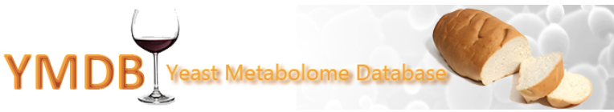


Open Source Databases

Slide 6
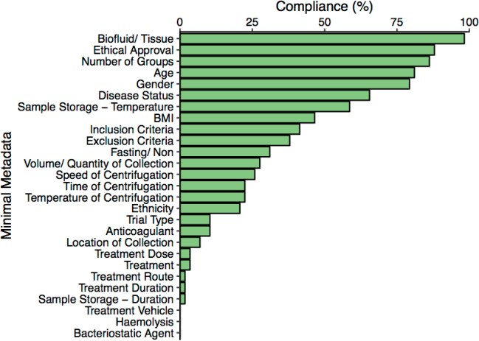
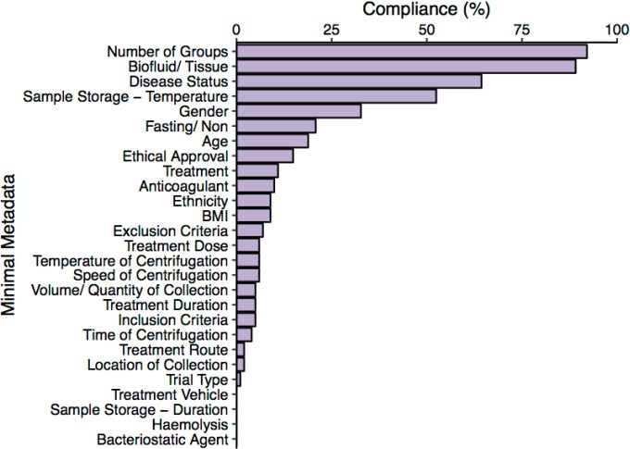
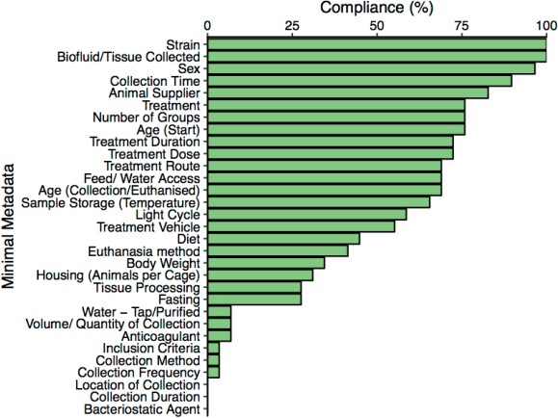
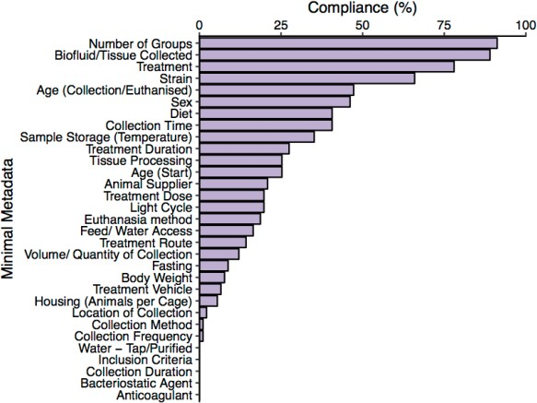
Human – Clinical reporting compliance
MetaboLights (n= 58)
Metabolomics Workbench (n= 99)
Overall % = 32.31%
Overall % = 17.49%
Mouse – Preclinical reporting compliance
MetaboLights (n= 29)
Metabolomics Workbench (n= 91)
Overall % = 47.28%
Overall % = 24.74%
Rachel Spicer

Slide 7
But the situation is improving!

Slide 8
Building blocks
Federated Data Sharing, Databases and Repositories
Minimum information reporting guidelines + Raw data and Open Access Data Standards
Infrastructure to store, access analyse the information

Slide 9
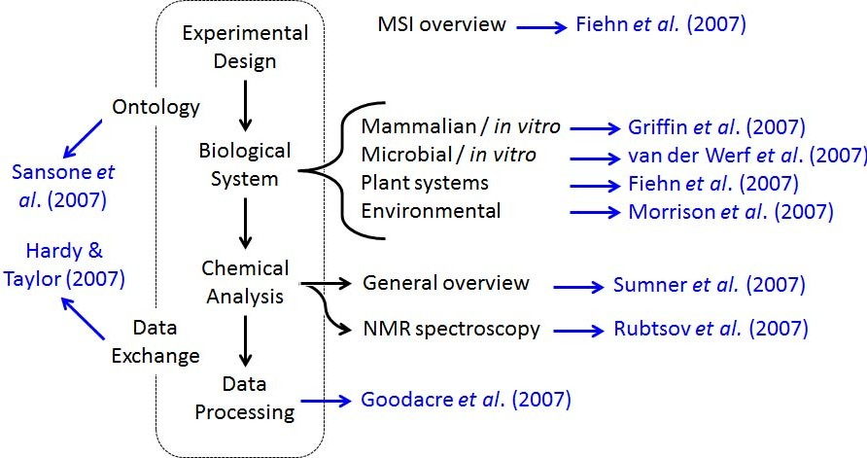
Metabolomics Standard Initiative (Minimum information)
Lives at http://msi-workgroups.sourceforge.net
5 Workgroups
Biological context metadata WG
Chemical analysis WG
Data processing WG
Ontology WG
Exchange format WG
Roy Goodacre Metabolomics (2014) 10:5-7

Slide 10
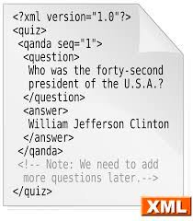
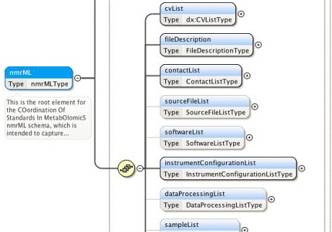

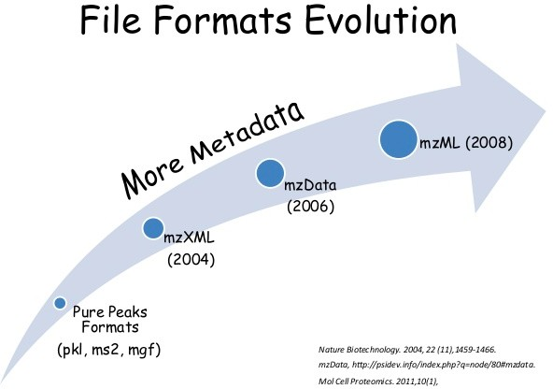
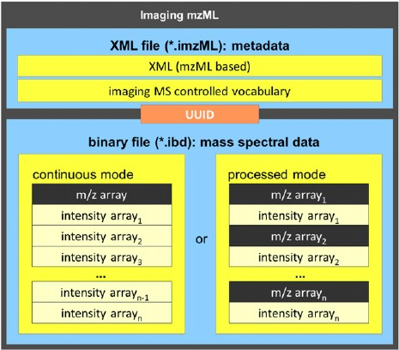
XML and Tab based Open standards

Slide 11

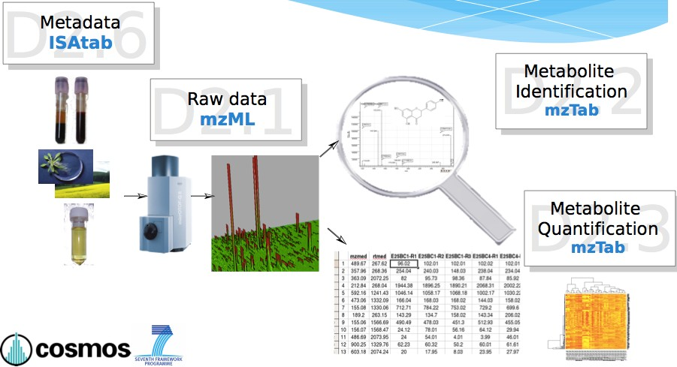


Overview of Data exchange standards
ISA-Tab
Metadata
mzTab Metabolite identification
mzML Raw Data
qcML QC Matrices
Slide from; Steffen Neumann (IPB-Halle), Proteomics and HUPO-PSI community

Slide 12
Building blocks data
Federated Data Sharing, Databases and repositories
Minimum information reporting guidelines + Raw data and Open Access Data Standards
Infrastructure to store, access analyse the information

Slide 13
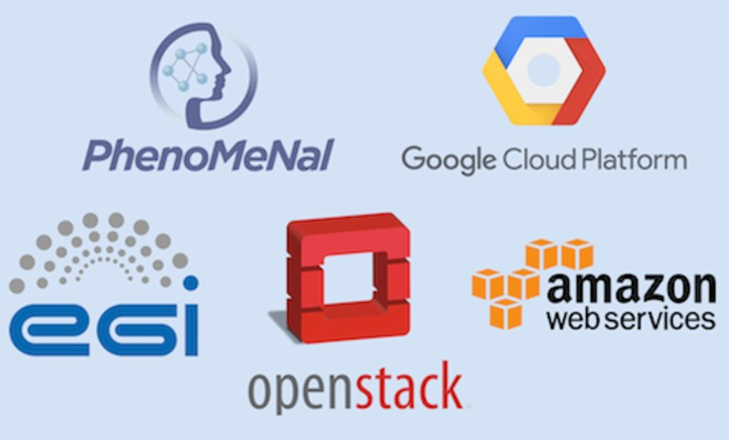

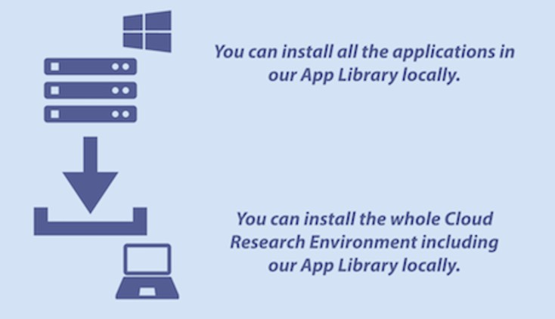

Scalability - Run locally or on the “cloud”

Slide 14
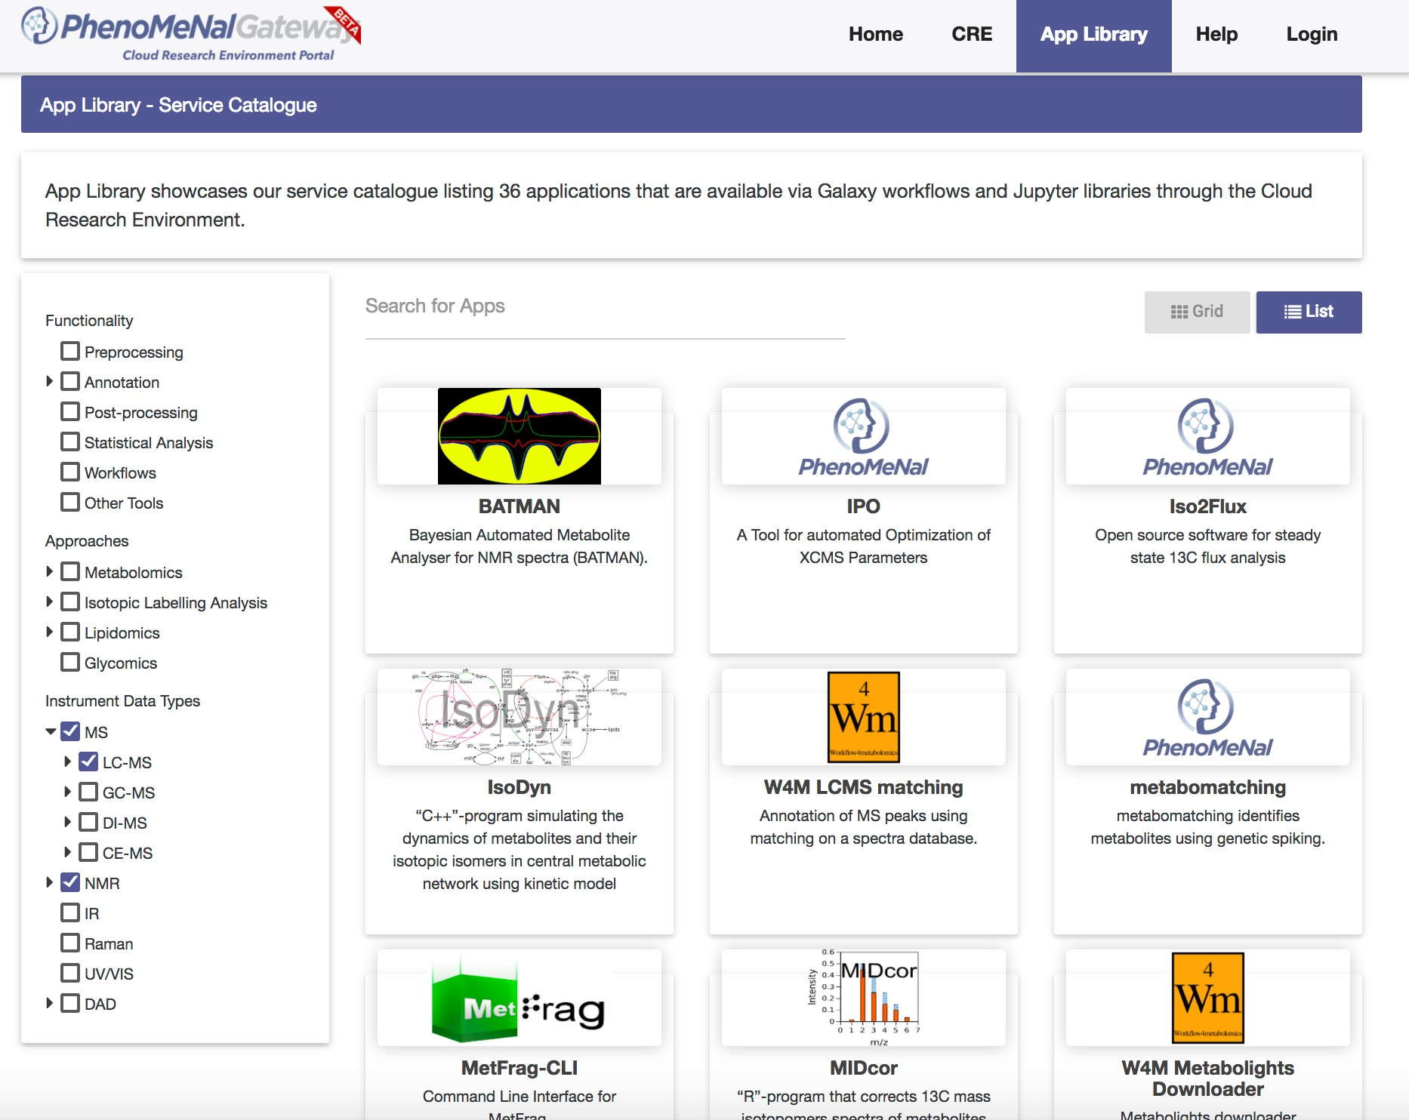

PhenoMeNal Gateway app

Slide 15
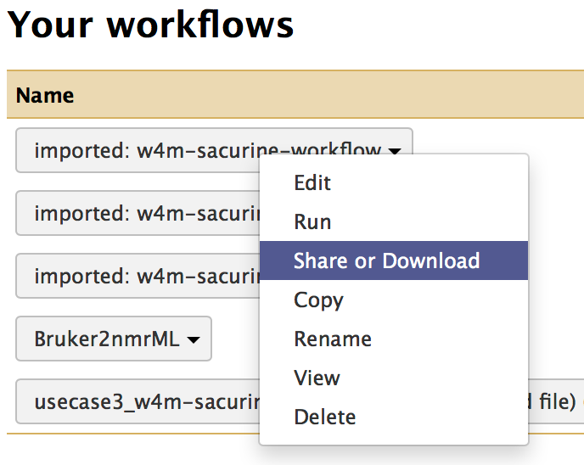
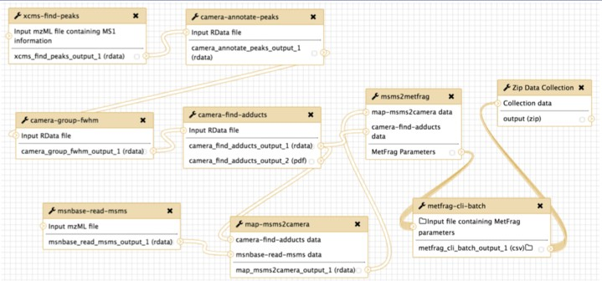
Example Workflows

Slide 16
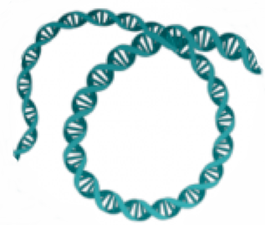
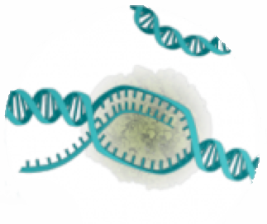
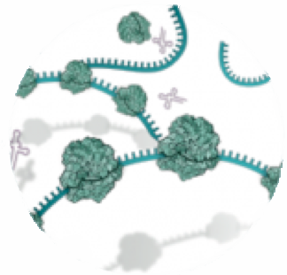
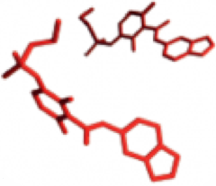
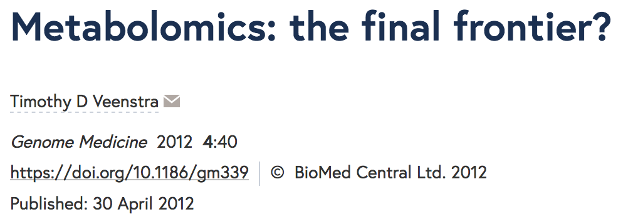
Metabolomics: Data management
Learn from the past
Gene
mRNA
Protein
Metabolite
Genomics
Transcriptomics
Proteomics
Metabolomics
Can metabolomics learn from the other omics and ensure how we go forward will be of maximum benefit as well as not being silo based?

Slide 17
Metabolomics: building the community
In 2017, researchers in the field of metabolomics got together in Frankfurt, Germany to discuss the
Priorities
Challenges
Bottlenecks
that we face and want to address as a community
van Rijswijk M, Beirnaert C, Caron C et al. The future of metabolomics in ELIXIR F1000Research 2017, 6(ELIXIR):1649 (doi: 10.12688/f1000research.12342.2)

Slide 18
Metabolomics: building the community
Outcomes:
The selection of metabolite identification as being the biggest challenge and bottleneck and hence priority
Application to become an Elixir community (accepted)
Application for Elixir implementation study (accepted – starting June 2018)
Will benefit from interactions with the existing five elixir platforms and progress will contribute most to other elixir communities

Slide 19
Metabolomics: implementation study
To create and extend metabolomics datasets
Supporting submission to and leveraging metabolomics data in MetaboLights and ChEBI ontology
providing a reference set of metabolites
Should share across the international databases
Notes:
The MetaboLights database holds information about individual metabolites, their chemistry, their spectral data (MS, NMR), as well as their role in pathways and biological systems.

Slide 20
Metabolomics: implementation study
To develop data analysis workflows for metabolomics
Will work with workflow management e-infrastructures such as Workflow4Metabolomics, PhenoMeNal, and Galaxy-M to develop the user-friendly, modular, and reproducible data analysis needed by the experimental community.
These will be run, saved, shared, and publicly referenced with digital object identifiers, and included in the ELIXIR bio.tools registry.
Should collaborate internationally to get other tools and resources into this environment

Slide 21
To support computing with large-scale metabolomics data
PhenoMeNal e-infrastructure enables researchers to use metabolomics workflows in public clouds (Amazon EC2, Google Cloud Platform) or in-house OpenStack environments in cases where sensitive data cannot leave the institution
Reduces the need for bioinformatics knowledge and focus on the interpretation
Enables reproducibility and submission to public resources where appropriate
open to new contributors
Metabolomics: implementation study

Slide 22
Metabolomics: why metabolite identification?
To increase the metabolomics training available
Will expand the delivery of metabolomics courses, for example through the European Metabolomics Training Coordination Group network.
Will create training partnerships with instrument vendors to increase the quality of training material and facilities.
Discussing with Metabolomics Workbench how we share this effort

Slide 23


Elixir Metabolomics Implementation Study
Node | Name of PIs | Action line
ELIXIR-NL | Thomas Hankemeier (lead) and Merlijn van Rijswijk (coordination) / Chris Evelo / Egon Willighagen | Coordination, interaction with other user communities / Interoperability
EMBL-EBI | Claire O’Donovan | Data / Interoperability
ELIXIR-FR | Etienne Thevenot / Franck Giacomoni / Caron Christophe / Victoria Dominguez | Tools / Data / Interoperability
ELIXIR-UK | Mark Viant / Rick Dunn / Ralf Weber / Susanna Sansone / Philippe Rocca-Serra / Tim Ebbels / Bobby Glen | Training / Data / Interoperability
ELIXIR-DE | Chris Steinbeck / Steffen Neumann | Data / Interoperability
ELIXIR-SP | Marta Cascante/ Vitaly Selivanov / Pedro de Atauri | Data / Interoperability
ELIXIR-GR | Maria Klapa/ Nicholas Moschonas / Martin Reczko | Tools / Data / Interoperability
ELIXIR-SE | Ola Spjuth / Kim Kultima | Compute / Tools
ELIXIR-IT | Gianluigi Zanetti / Luca Pireddu | Tools
ELIXIR-EST | Ruth Shimmo / Kairi Koort | Data / Interoperability
ELIXIR-CH | Alan Bridge / Ioannis Xenarios | Data / Interoperability
ELIXIR-BE | Dirk Valkenborg | Tools

Slide 24

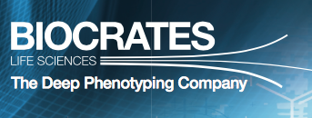
Metabolomics: Data management
FAIR Guiding Principles
Findable
Accessible
Interoperable
Re-useable

Slide 25
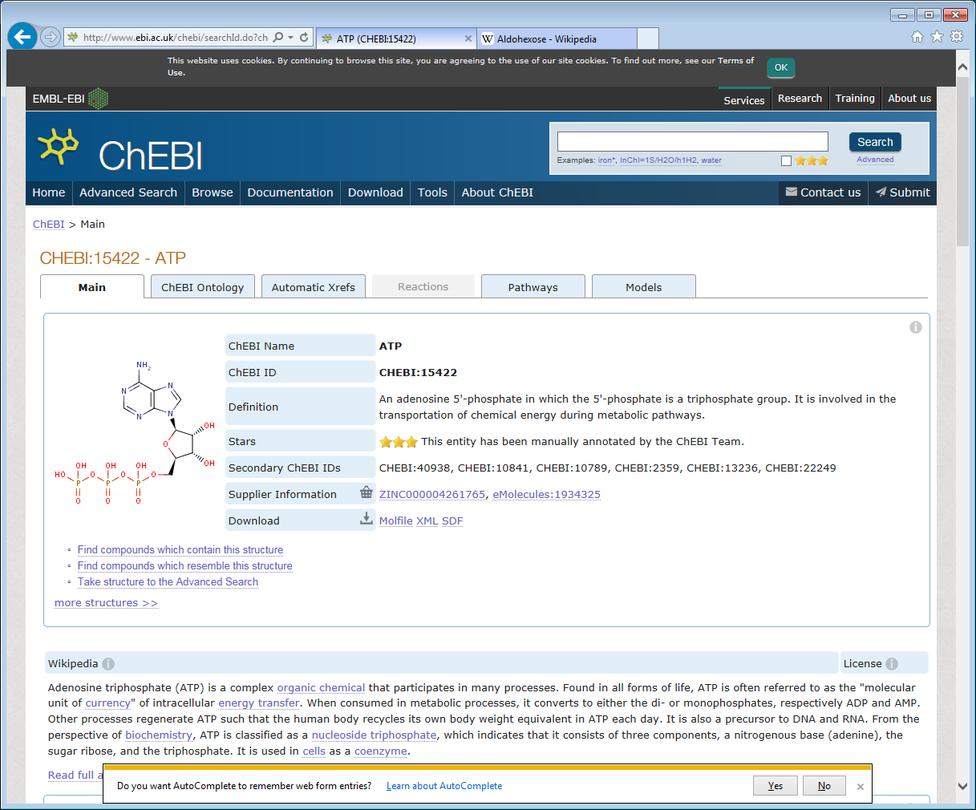
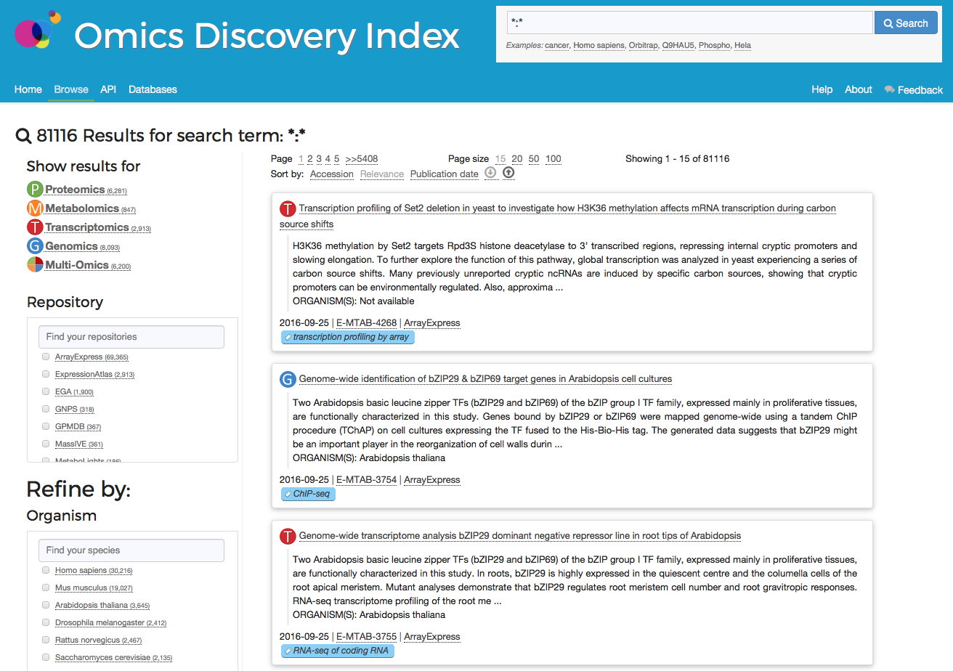
MetaboLights - Open Source Database
Sample Collection
Sample Preparation
Analytical Analysis
Data Interpretation
Cross species, cross technique
Comprehensive information collection
Open access, discoverable through various portals

Slide 26
Going forward - FAIR
Increasing the availability of data: Findable/Accessible
Improving submission process
for individual researchers with easy to use interface, analysis tools and effective training
For larger centres/consortiums with templates and programmatic submission
Clinical data through EGA collaboration and NIHR Bioresource
National data eg Birmingham phenome centre
Industry eg Metabolon, Biocrates
Alliance of Genomics Resources (AGR) eg WormBase, FlyBase

Slide 27
Going forward - FAIR
Interoperable and Reusable
Standards!!! BUT balancing appropriate/completeness/sufficient – need more use cases
Using “global” ontologies
Need to collaborate closely at study design stage/grant writing – not as afterthought in data mgmt section
Training
introduction to metabolomics for study commissioners and clinicians/biologists struggling with interpretation
Development of standardized reproducible workflows

Slide 28
Open Source Databases

Slide 29







MetaboLights – Endorsed by journals
Notes:
More and more publishers require open data access before approving publications. For example The Metabolomics journal and Nature Publishing Group Scientific Data
recommends submitting to MetaboLights prior to publication.

Slide 30
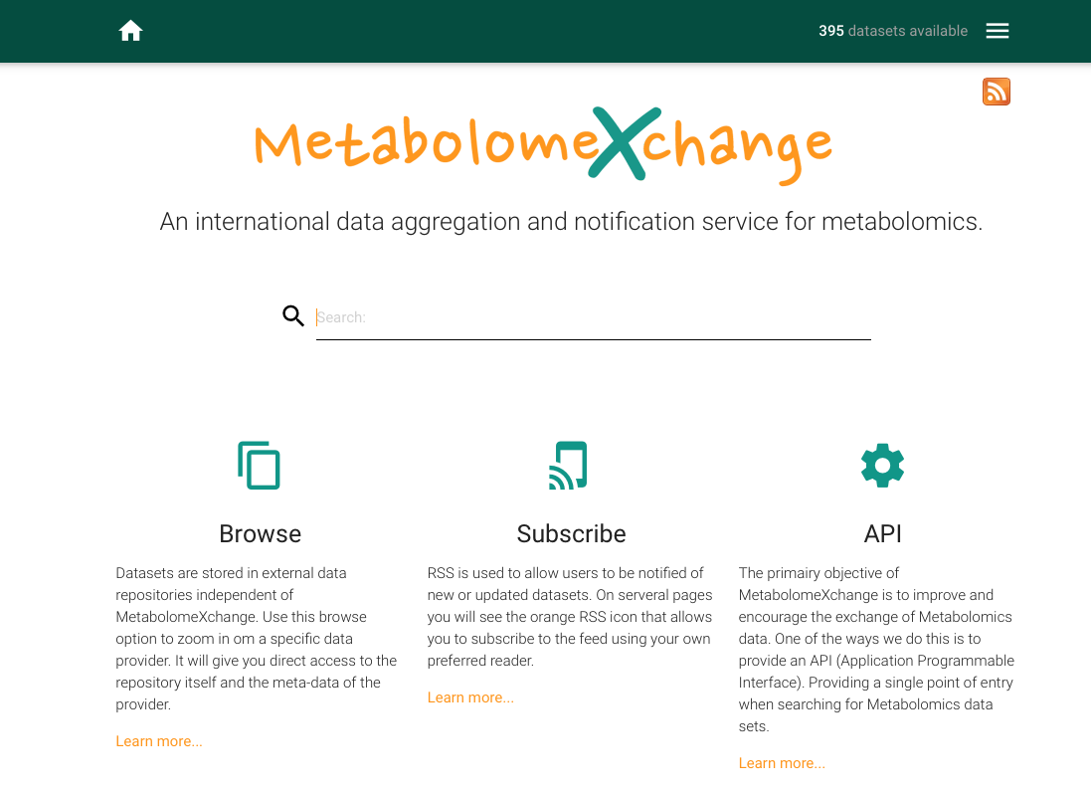

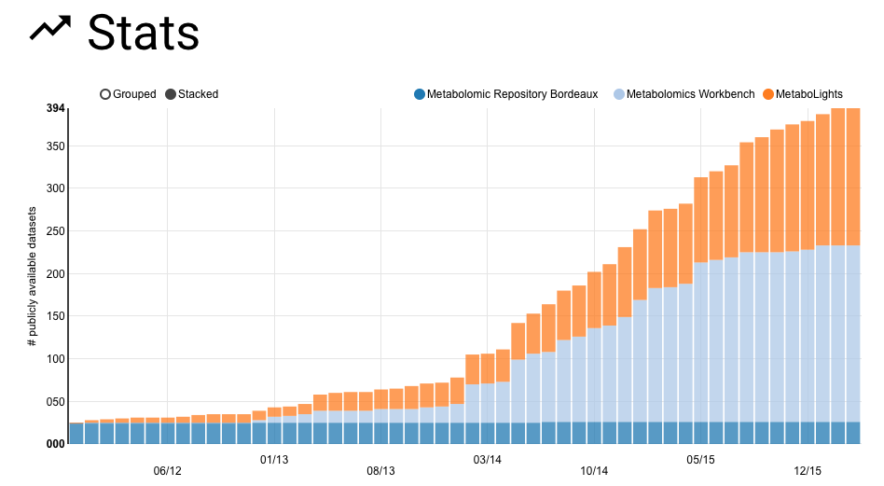
http://metabolomexchange.org
-
Notes:
MetaboLights is one of the founding members of the MetabolomeXchange consortium, and we share all public data
Need to explore minimal standards as talked about yesterday
Japanese metabolonote

Slide 31
Omics Discovery Index - www.omicsdi.org
Notes:
MetaboLights also share data with the NIH BD2K funded OmicsDI, this is a resource to discover specific and multi-omics datasets

Slide 32
Metabolomics: Across the omics…
Gene
mRNA
Protein
Metabolite
Genomics
Transcriptomics
Proteomics
Metabolomics
Metabolomics is complementary to genomic and proteomic studies
Whereas genes and proteins are subject to regulatory epigenetic processes and post-translational modifications, respectively, metabolites represent downstream biochemical end products that are closer to the phenotype.
Accordingly, it is easier to correlate metabolomic profiles with phenotype compared to genomic, transcriptomic and proteomic profiles

Slide 33











Metabolomics Team at EMBL-EBI
Kenneth Haug
Keeva Cochrane
Pablo Moreno
Kalai Jayaseelan
Jiakang Chang
Jose Ramon Macias Gonzalez
Mark Williams
Rachel Spicer
Namrata Kale
Venkata Chandrasekha “Chandu”
Claire O’Donovan
(PI)
r

